Slide 1
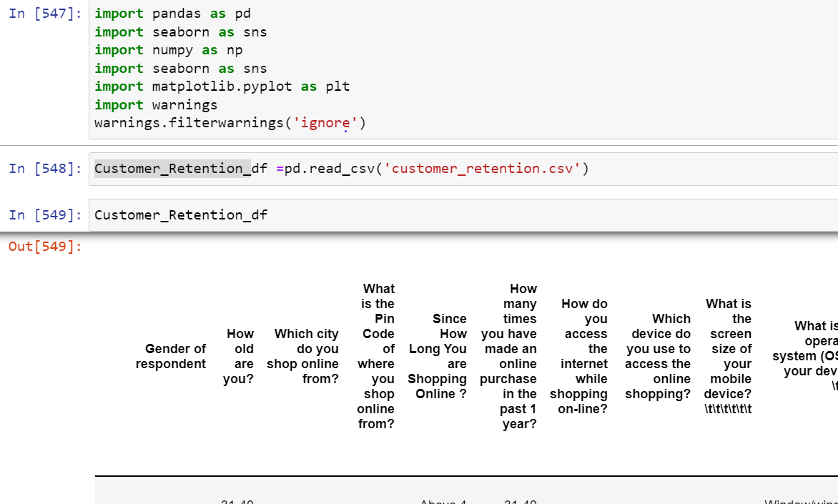
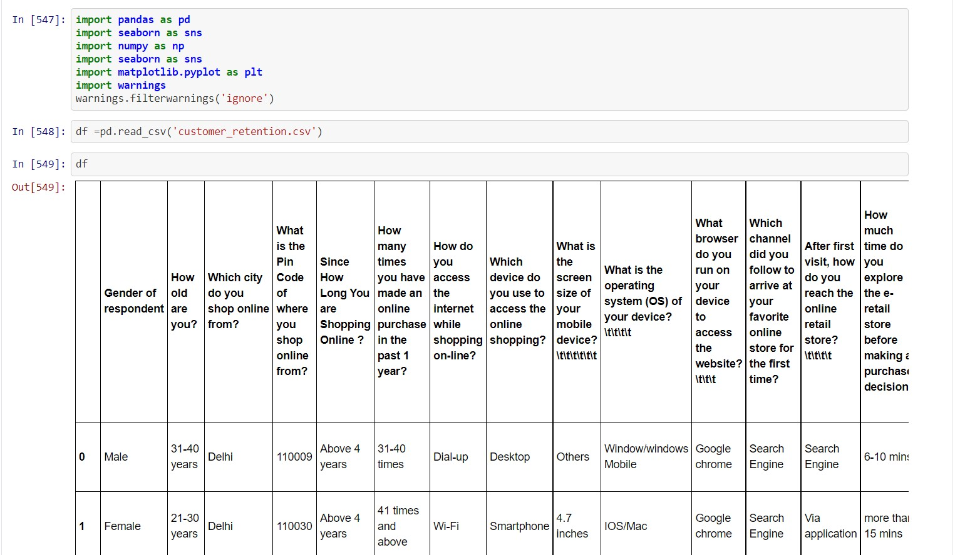
Customer Retention
Customer retention refers to the activities and actions companies and organizations take to reduce the number of customer defections. The goal of customer retention programs is to help companies retain as many customers as possible, often through customer loyalty and brand loyalty initiatives. It is important to remember that customer retention begins with the first contact a customer has with a company and continues throughout the entire lifetime of the relationship.
Load the basic Libraries and Load the data of Customer Retention
There many columns that show how customer action towards company in this case e-retailer e- commerce platform
Customer_Retention_df.columns
show the columns present in data set

Slide 2
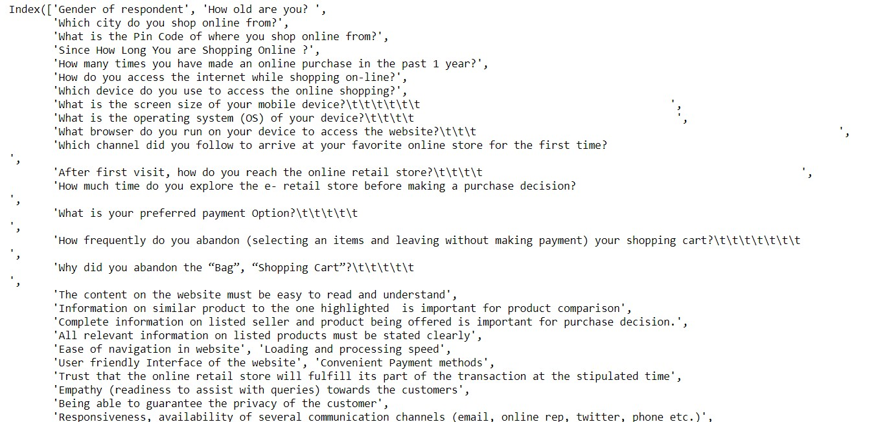
#### display max columns and rows pd.set_option("display.max_columns", None) pd. set_option("display.max_rows", None)
### Replace the space and unwanted space from columns Customer_Retention_df.columns = Customer_Retention_df.columns.str.replace(' ', '')
Customer_Retention_df.columns = Customer_Retention_df.columns.str.replace('\t\t\t\t\t\t', '') Customer_Retention_df.columns = Customer_Retention_df.columns.str.replace('\t\t\t\t', '') Customer_Retention_df.columns = Customer_Retention_df.columns.str.replace('\t\t\t', '') Customer_Retention_df.columns = Customer_Retention_df.columns.str.replace('\t', '')
### check count of null value Customer_Retention_df.isnull().sum()

Slide 3
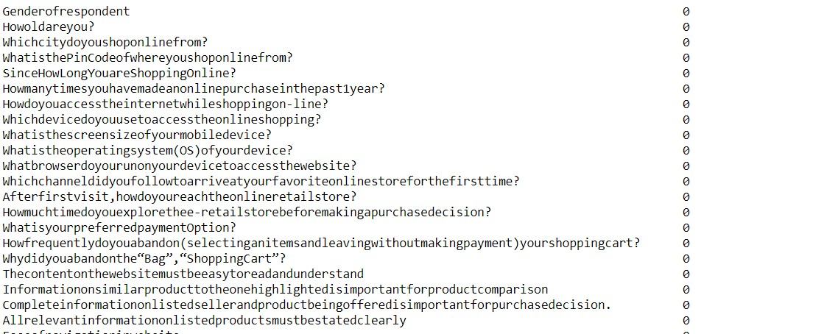
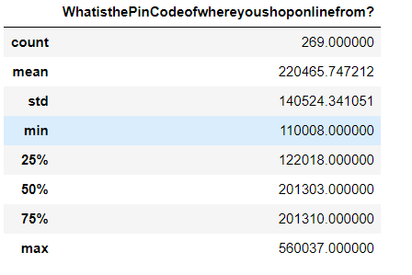
#### Statistical description show only numeric value Customer_Retention_df.describe()
#### statistical data type description Customer_Retention_df.dtypes

Slide 4
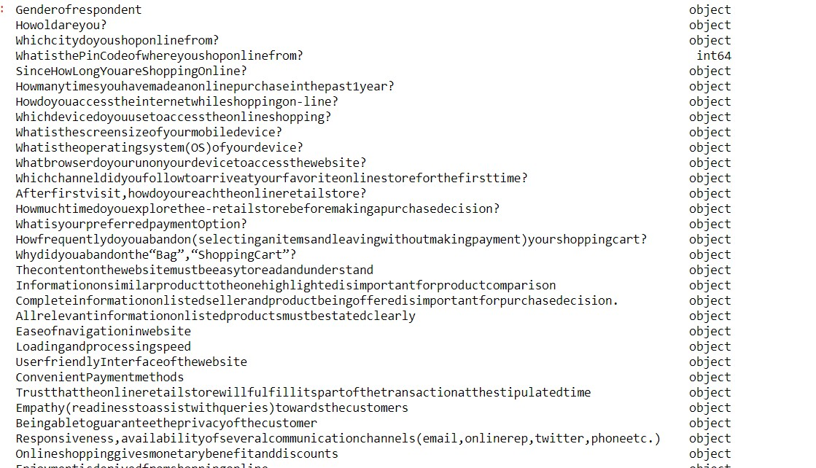
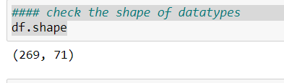
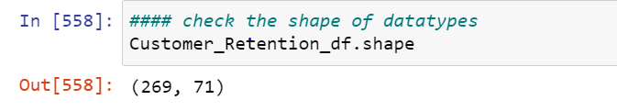
Most of the columns are in categorical form so it is clear to apply encoding technique like label encoder/one hot encoding
#### Check the shape of datatypes Customer_Retention_df.shape
There are 269 Rows and 71 Columns
#### some Data visualization to understand the data set

Slide 5
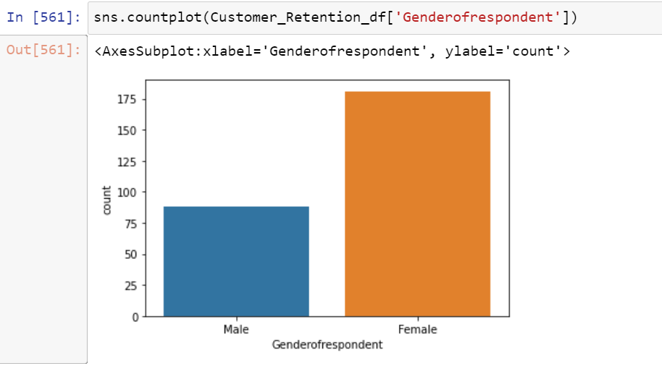
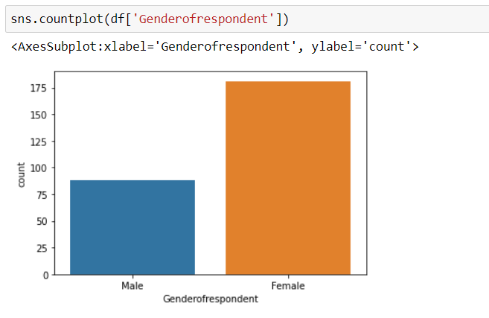
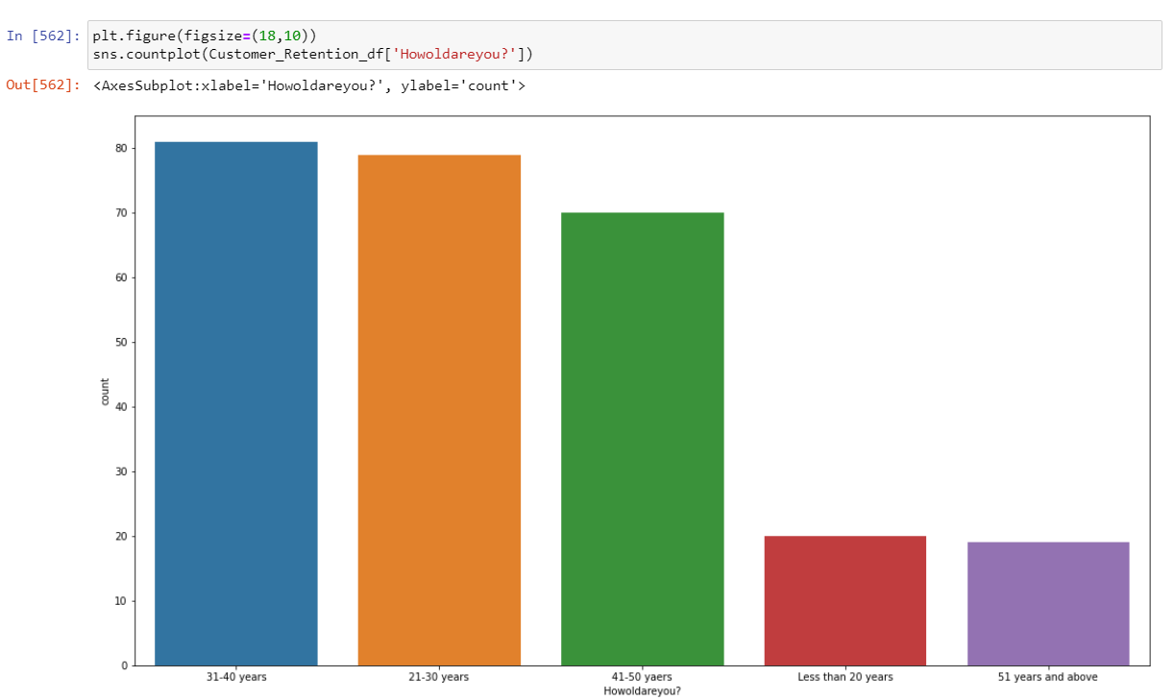
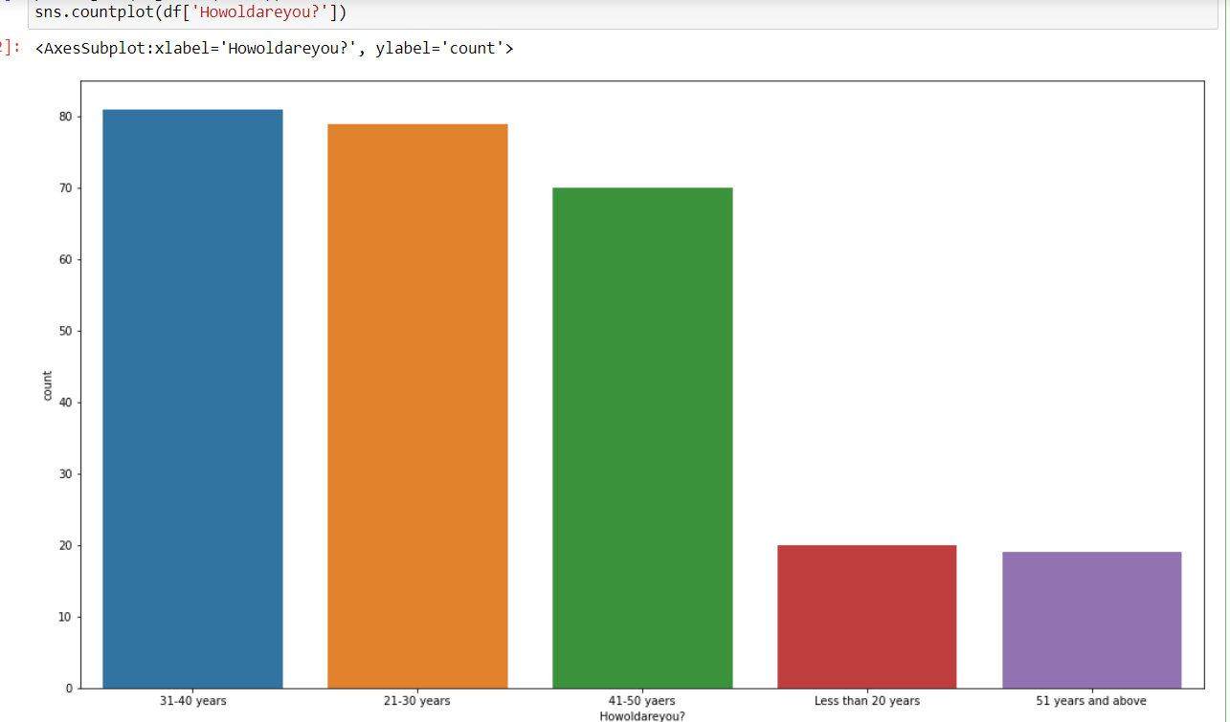
Female count is more than male in term of gender of respondent in e-commerce retailer
Mostly 31-40 years and 21-30 years use e-retailer shop more than others

Slide 6
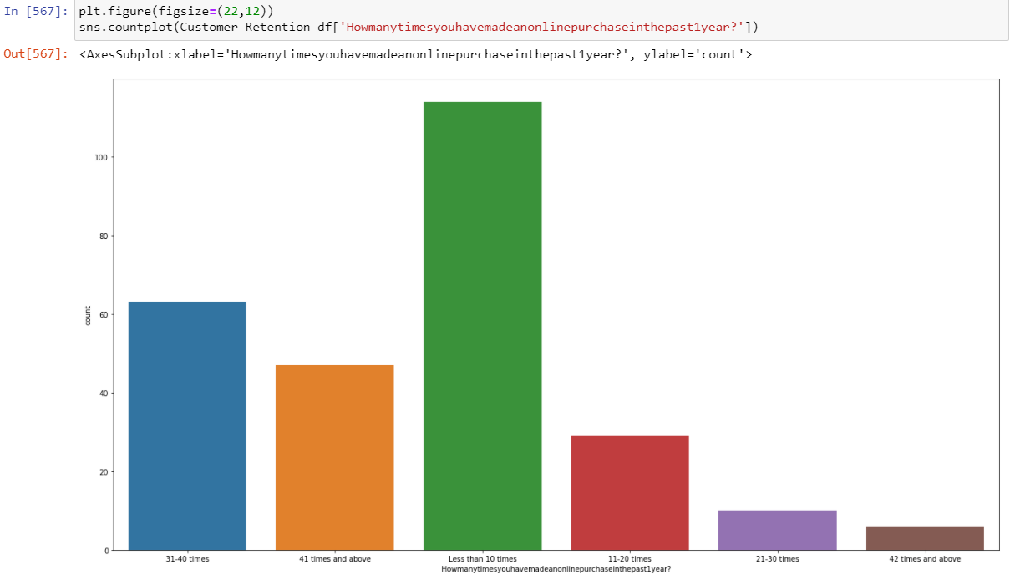
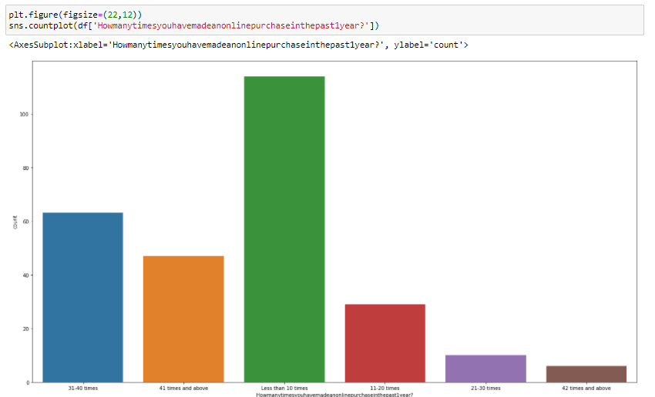
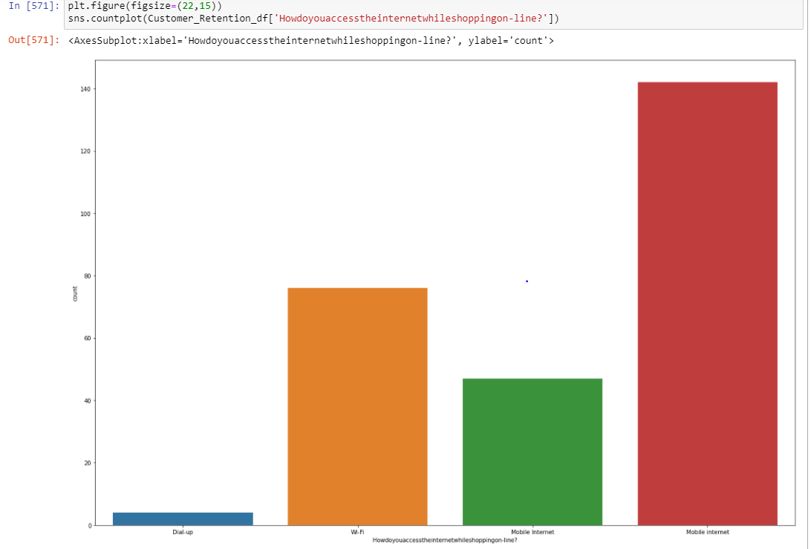
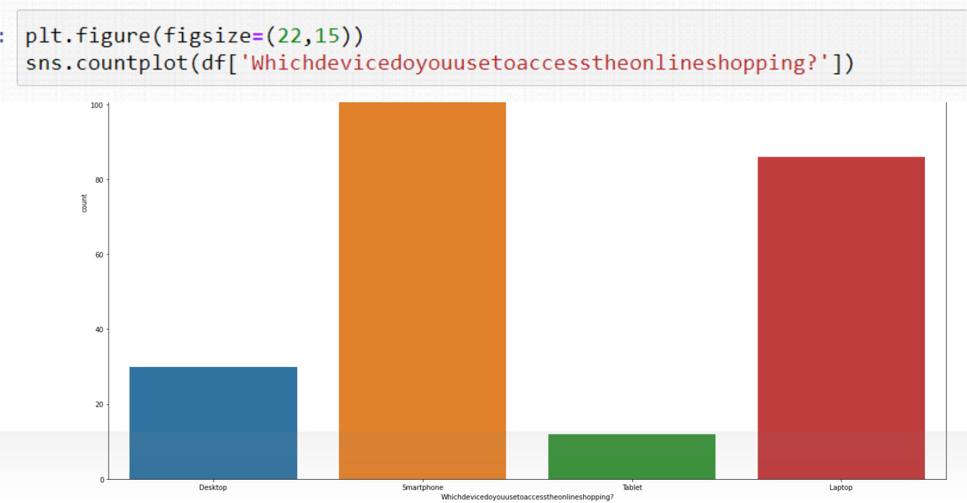
Less than 10 times people did purchase in past 1 years. It means it is not good for the e-commerce platform.
Mostly People use smartphone for online shopping.

Slide 7
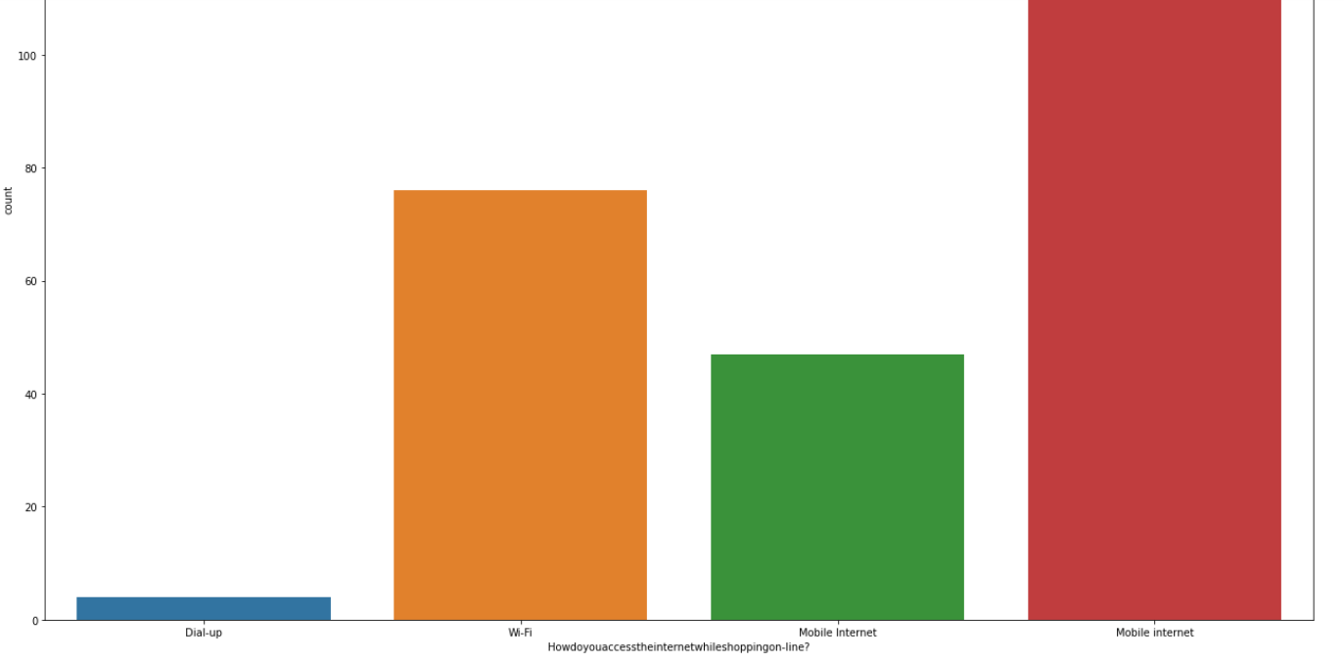
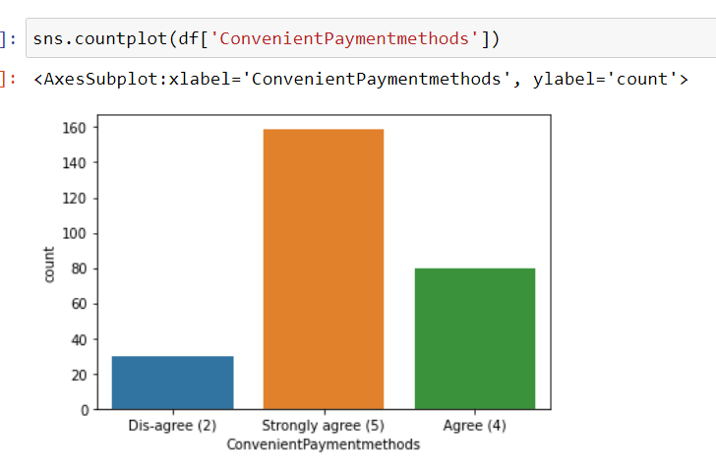
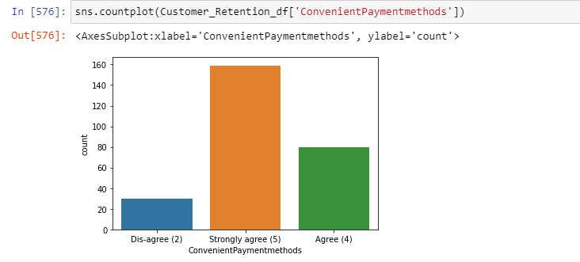
Mostly People use mobile internet for shopping.
Continent Payment Method is Strongly agree for payment method.

Slide 8
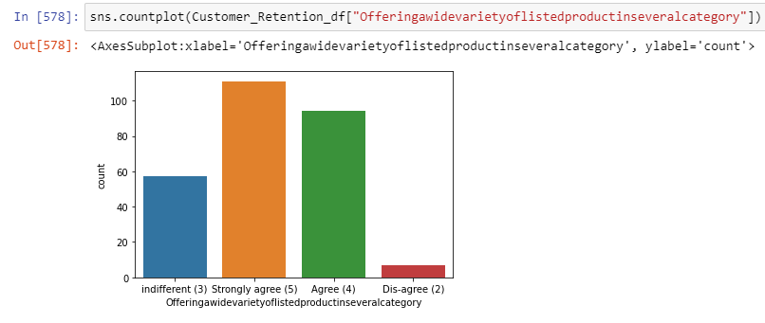
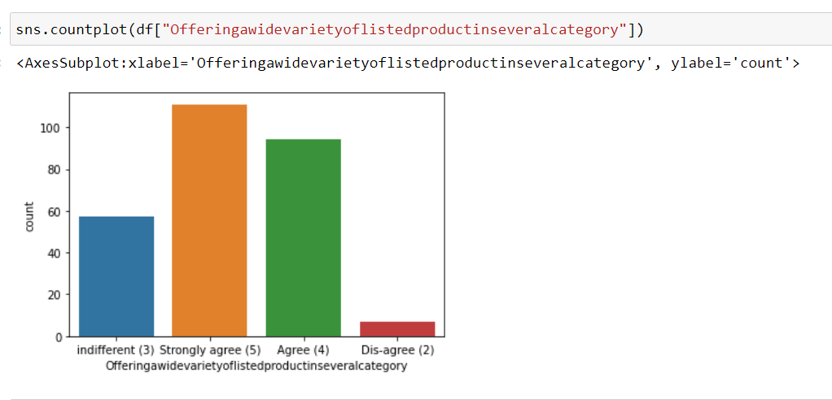
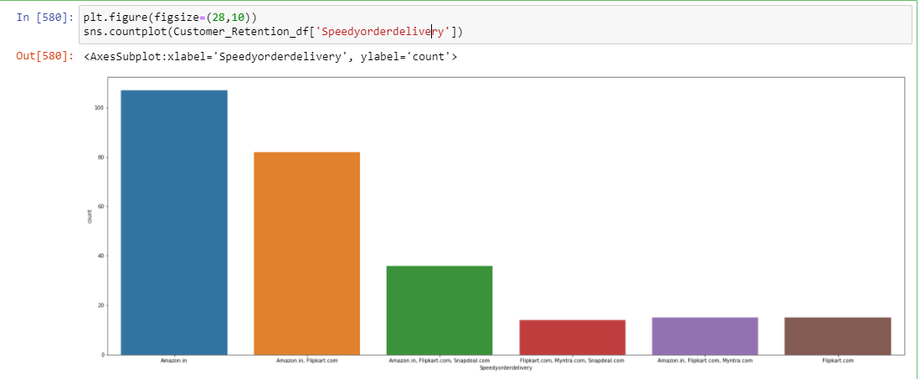
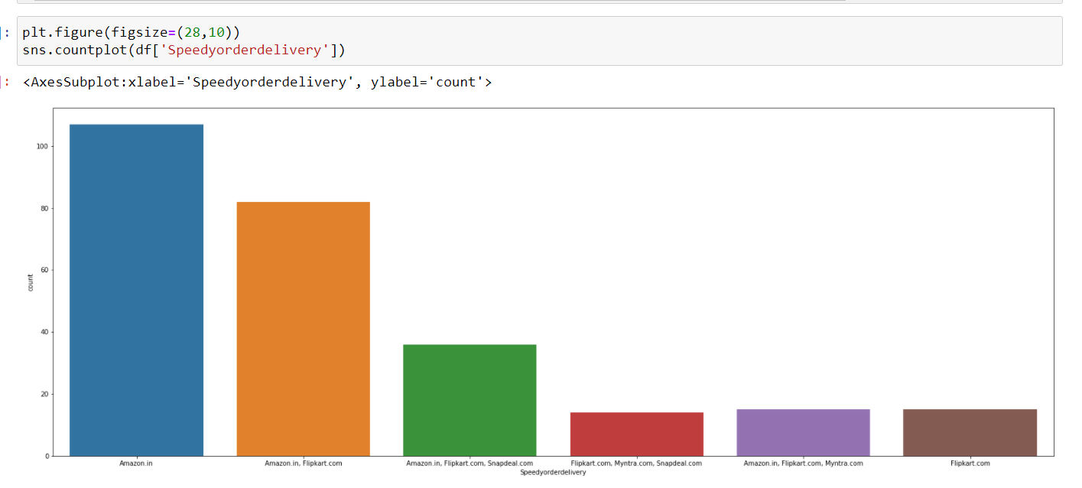
This graph shows that e-store provide wide variety of list of product in several category (Strongly agree)
Mostly Amazon gives the speed of the delivery.

Slide 9
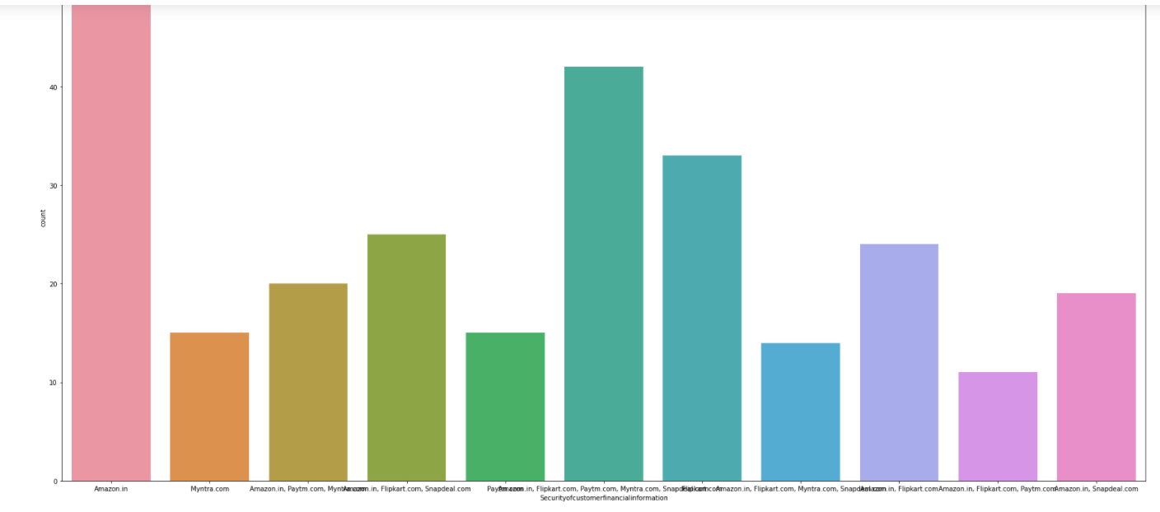
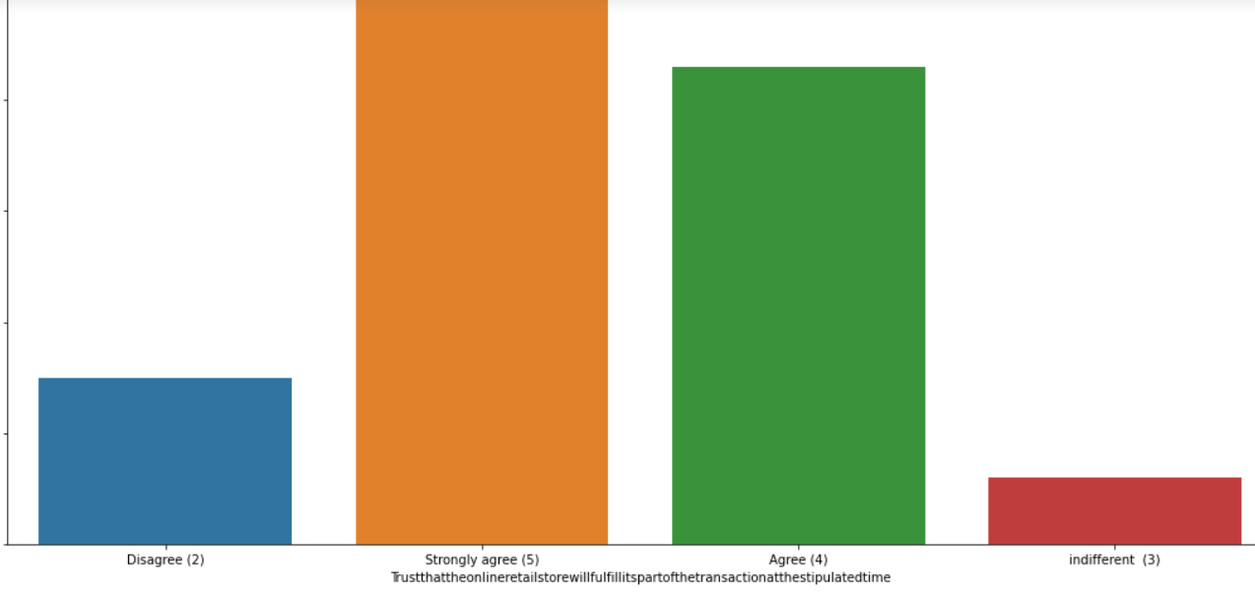

Amazon keeps the the security of customer financial information mostly shown in graph and its seems to good for the customer.
people stronly agree for the Trust that the online retail store will fulfill its part of the transaction at the stipulated time.

Slide 10
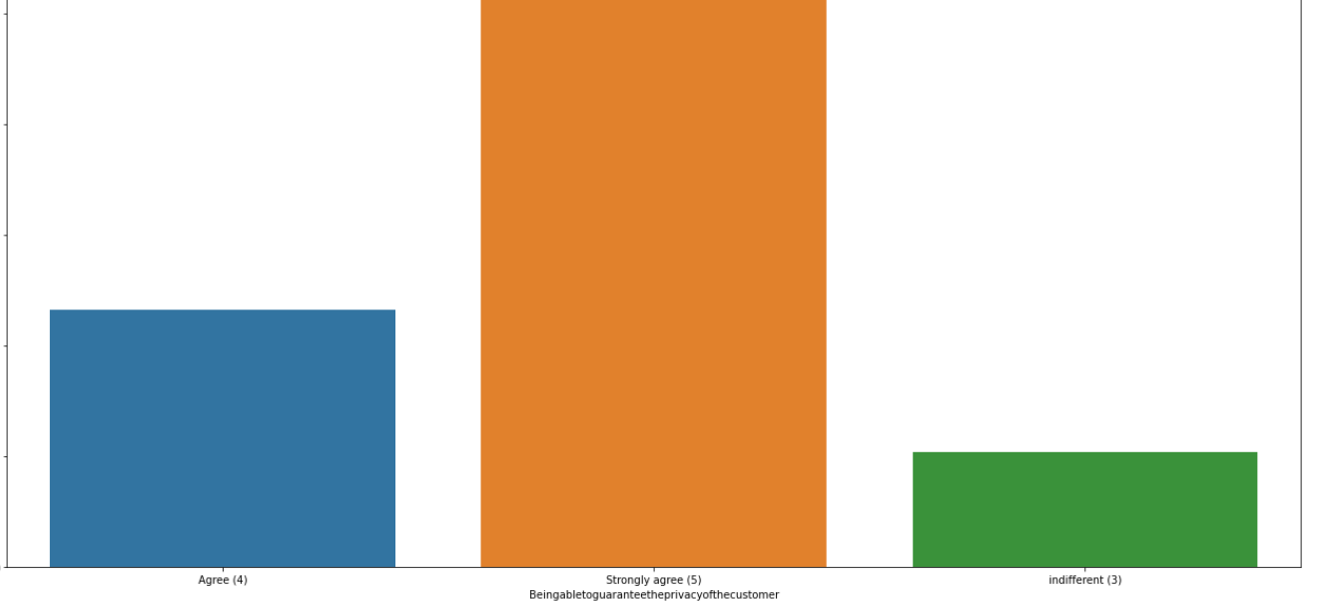
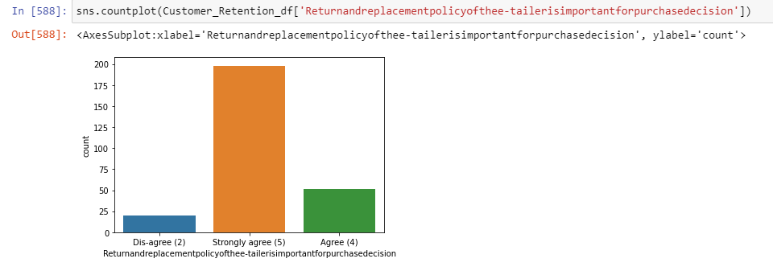
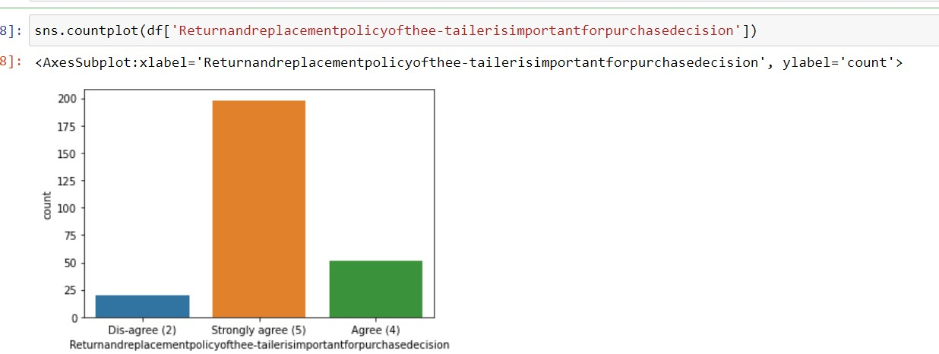

It Strongly agree for Being able to guarantee the privacy of the customer.
Strongly agreed for the Return and Replacement policy is important for purchase decision is strongly

Slide 11
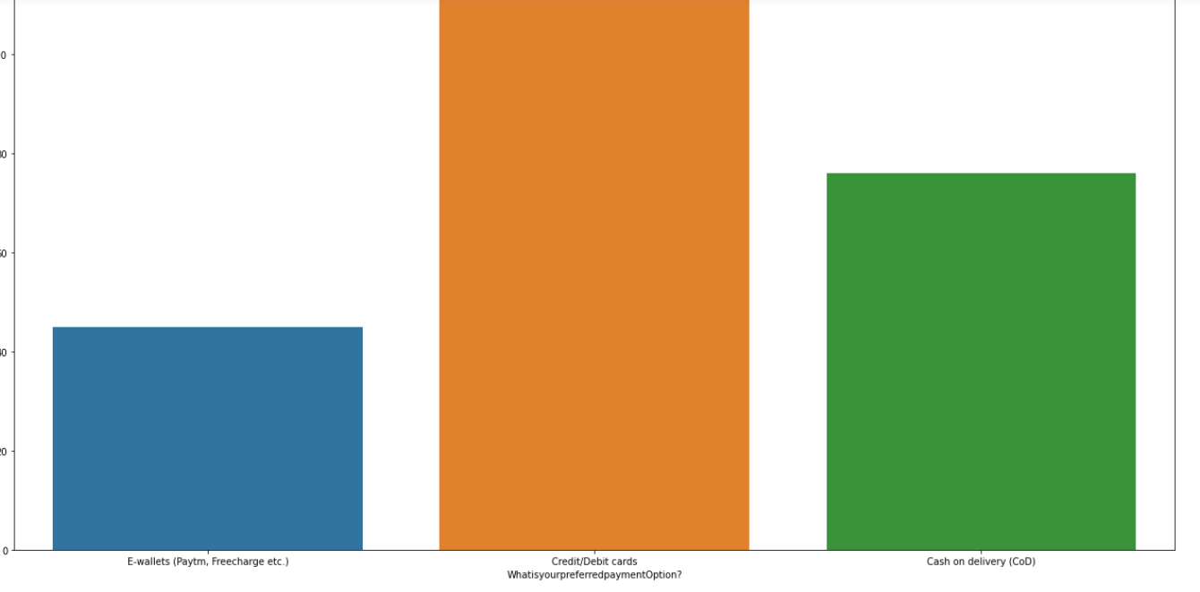
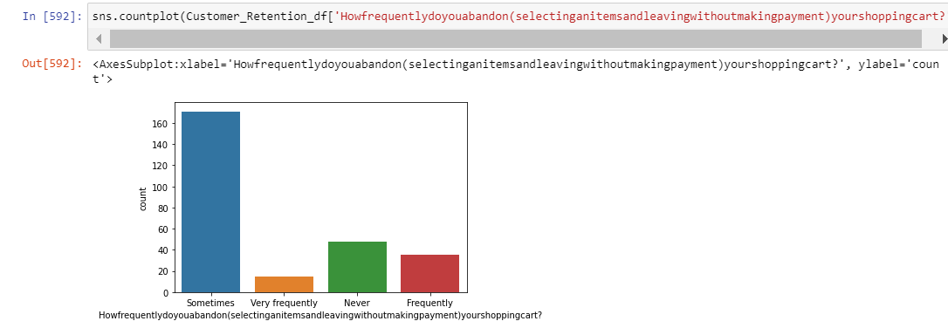
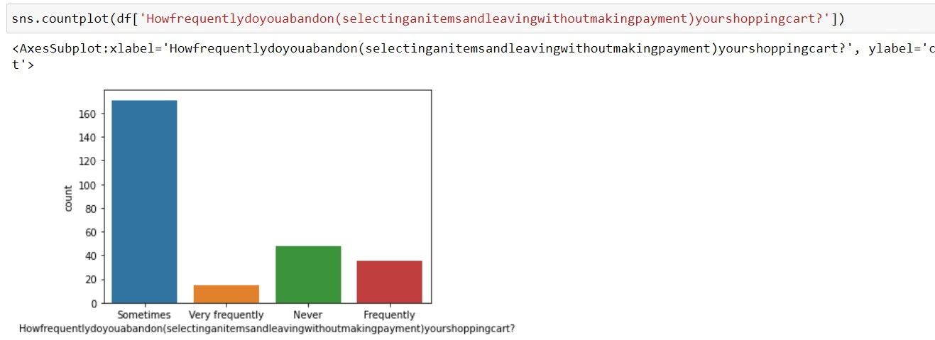
Credit/debit card is perfered payment option choosen higly by the cutomers for online shopping.
Sometimes is highly countable for selecting and leaving without making payment

Slide 12
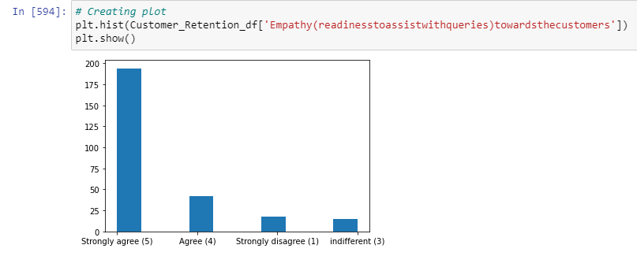
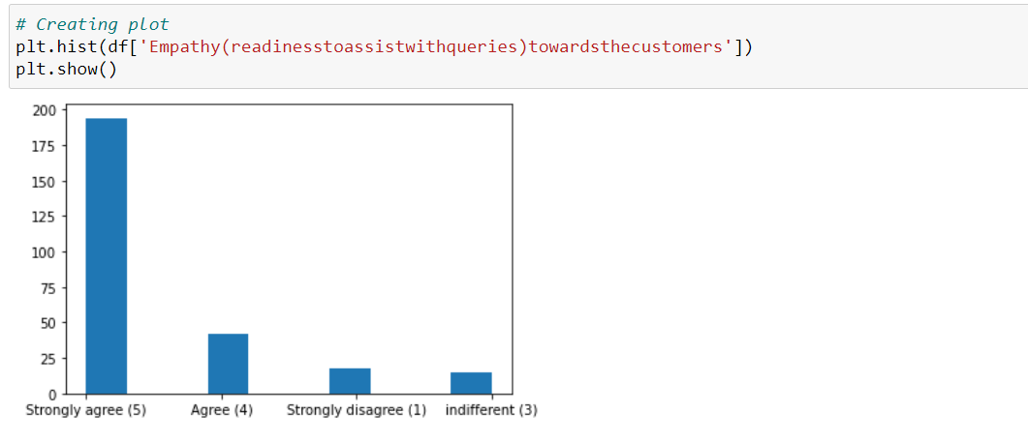

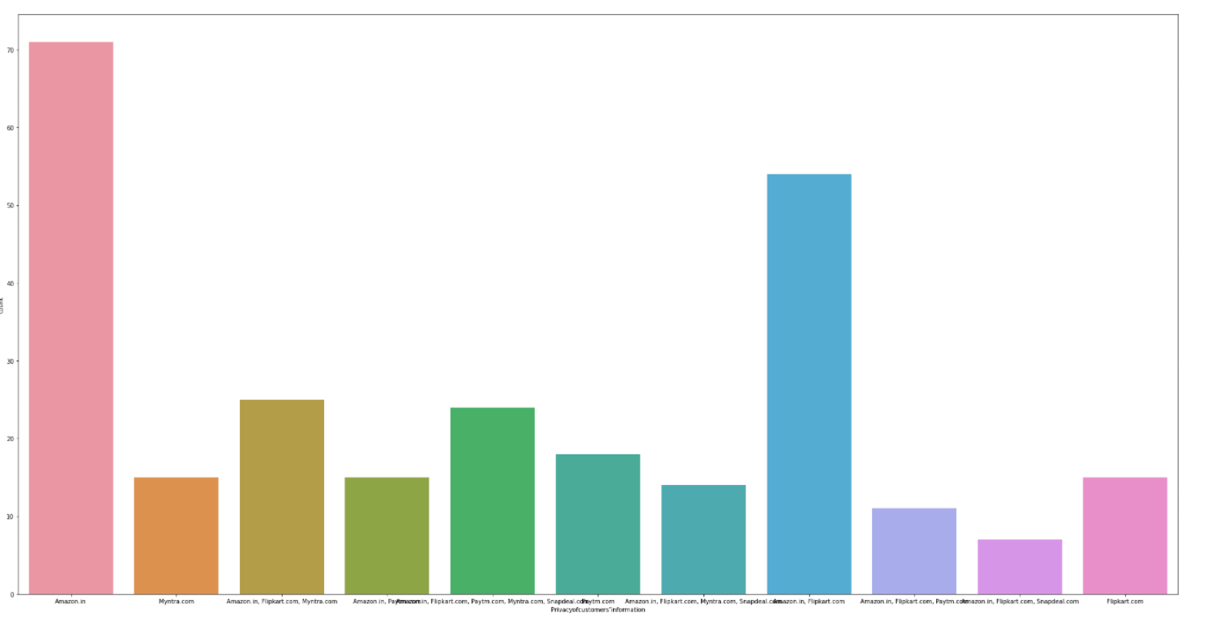
Online Strongly agreed towards Empathy readiness to assist with queries towards customer which helps more to bind the relationship.
Amazon keep the customer policy information of customers
Pre-processing

Slide 13
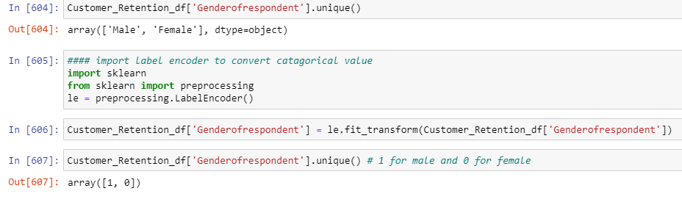
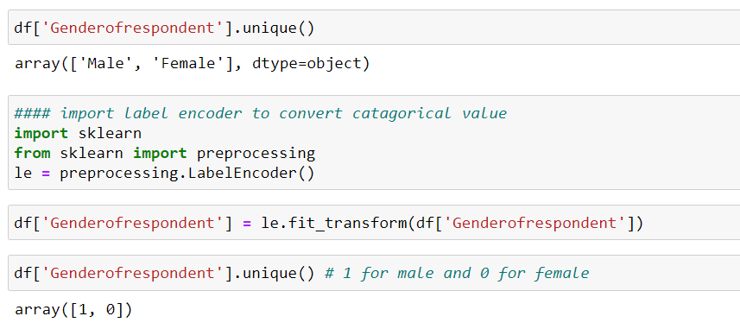
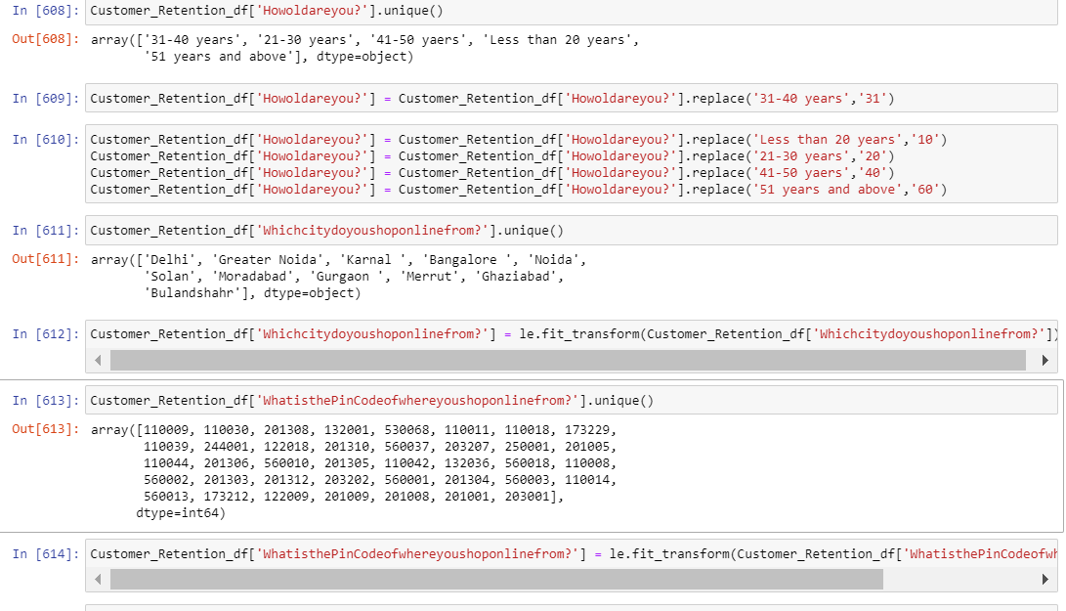
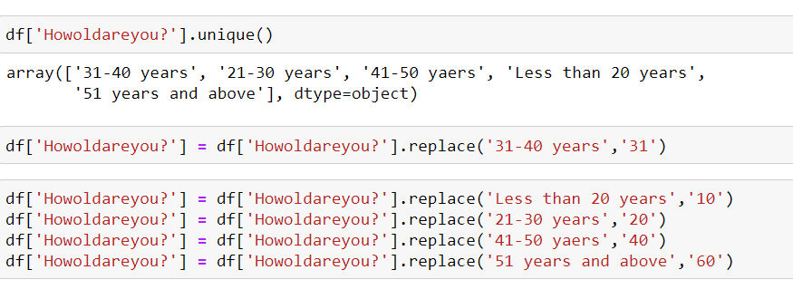
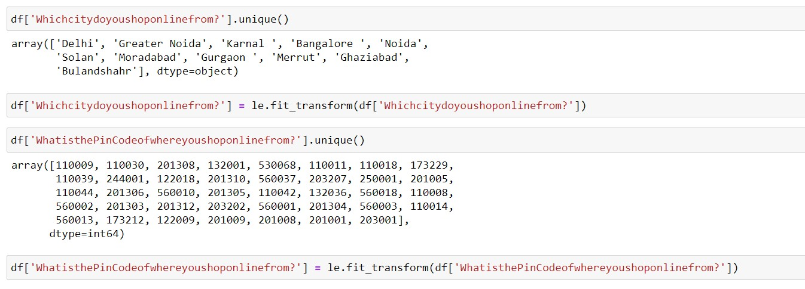
Gender of Respondent have two categorical value which convert into 0 and 1.
## All columns are in categorical in behavior so each column have been encoded with the help of encoder or use replace function to convert categorical value into numerical value.

Slide 14
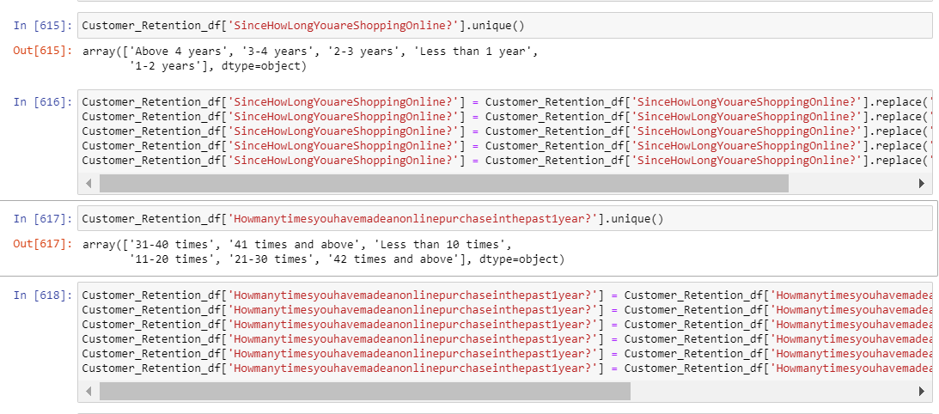
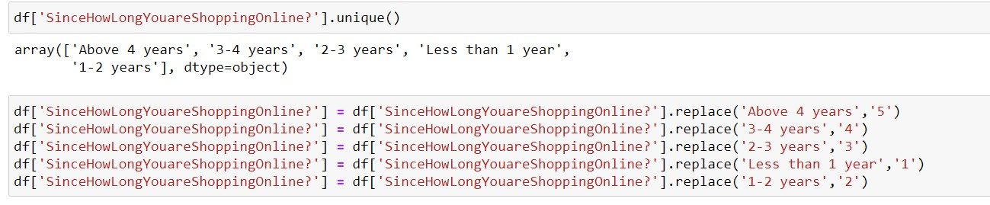
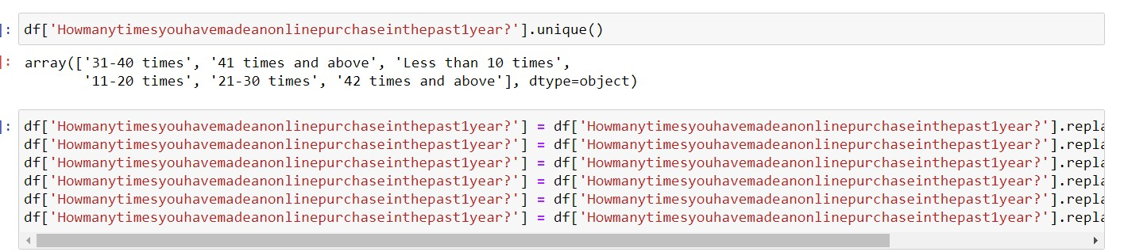
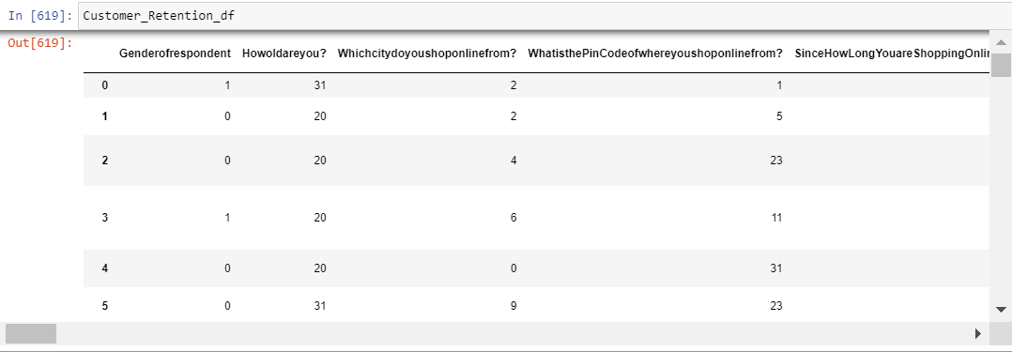
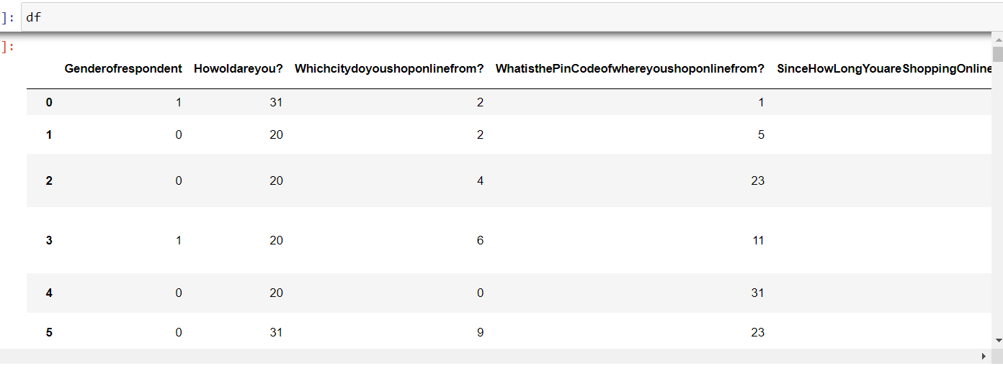
Check weather the columns are in categorical is converting into numerical or not

Slide 15
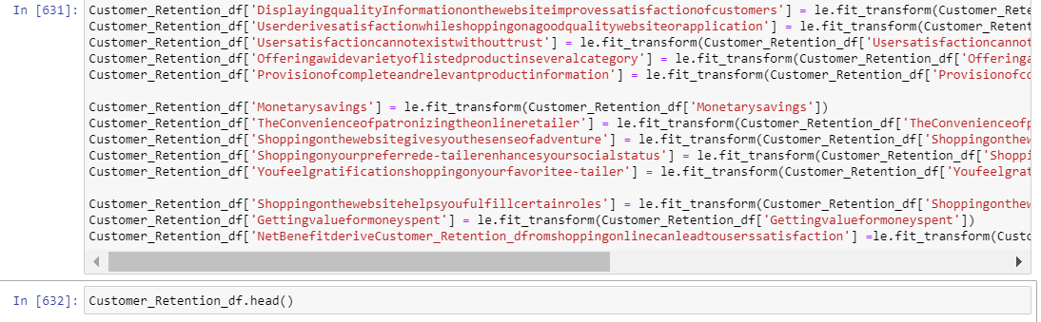
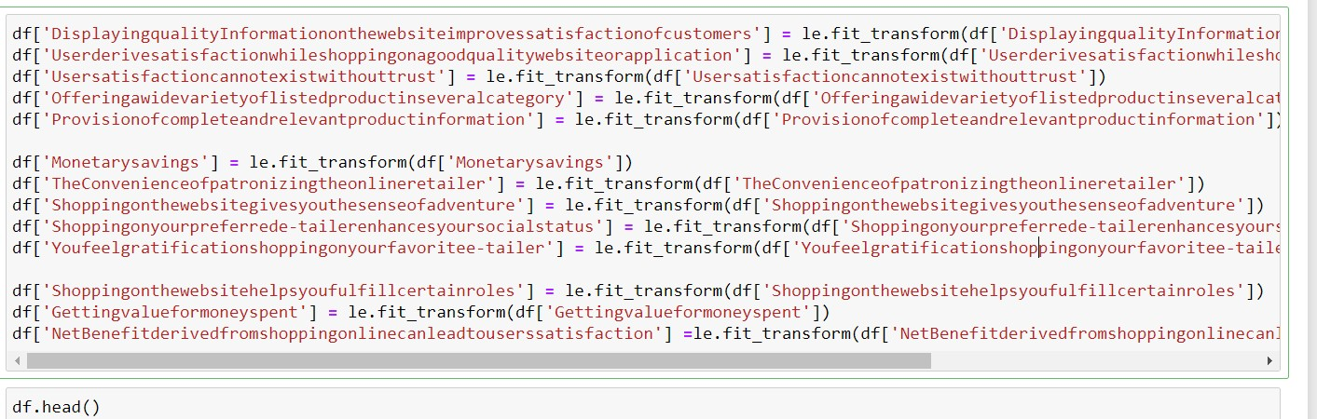
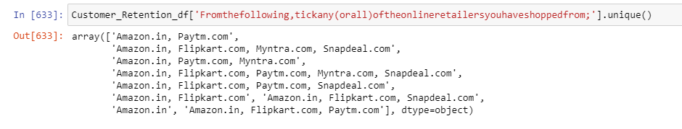
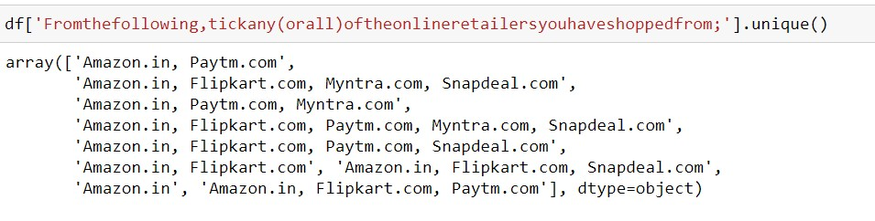
### head function show top 5 rows from the dataset

Slide 16
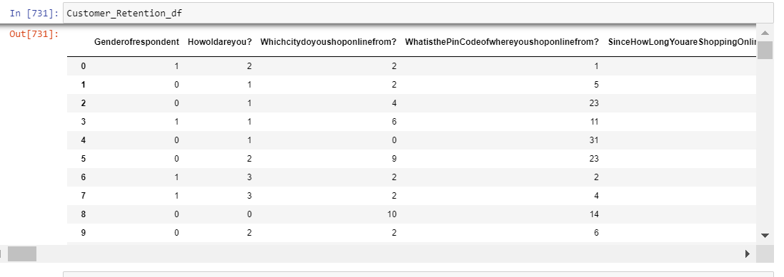
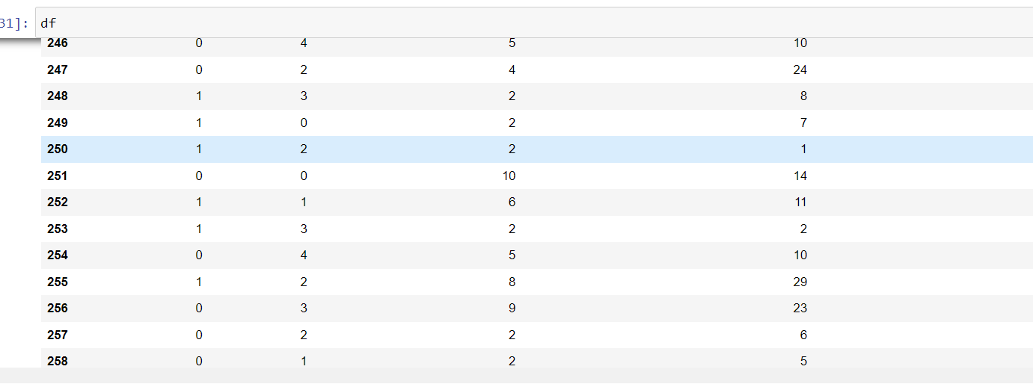
Conclusion:
Customer aspect various things from the online store like privacy, vide variety of product, payment Efficiency, fast delivery orders, mostly used payment method many more. If customer gets the satisfaction, it automatically builds the relationship. From visualization customer agree with payment option , fast delivery/speedy delivery ,privacy of customer information and privacy of account/financial statement. I have visualized the scenario to understand what customer need during online shopping so any one feasible to keep relationship .After Visualization clean the data remove missing value and used scaling techniques for building the best model.

